Slide 1


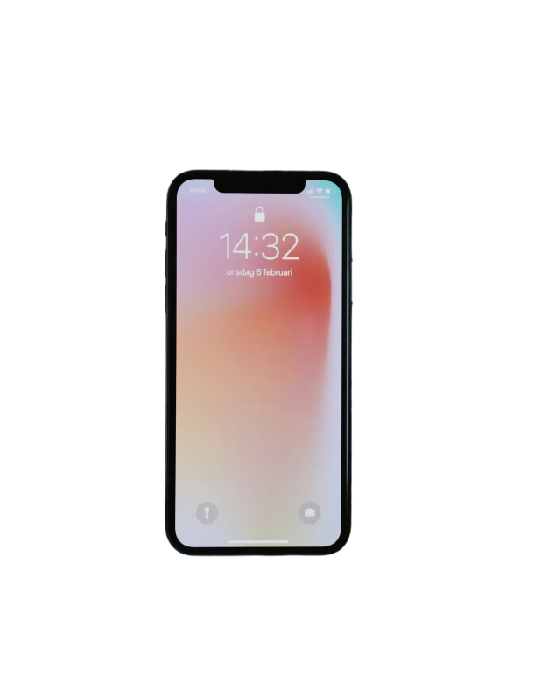








Databases
Team Project
Mobile app API development presentation
Mobile app API development
TEAM 9 - 송민의, 정용준, 정지호, 고효경, 남윤정

Slide 2







Mobile app API development presentation
Community
Share information and communicate with users
Timetable
Effectively manage class schedules
Course Review
Contribute to improving the learning environment through reviews of courses.
Everytime is an all-in-one platform designed to help university students manage their academic lives smartly. By integrating academics, community activities, and information sharing in one place, it simplifies the complexity of college life and makes it more efficient.

Slide 3


Mobile app API development presentation
Bulletin Board
Share information and communicate with users
Post
Share information and communicate with users
Course Review
Contribute to improving the learning environment through reviews of courses.
Everytime consists of three main views: Bulletin Board View, Post View, and Course Evaluation View. Users can explore and share information through bulletin boards and posts, while the Course Evaluation View allows them to write or read course reviews to aid in academic planning. These features efficiently support students in managing information and communication.

Slide 4

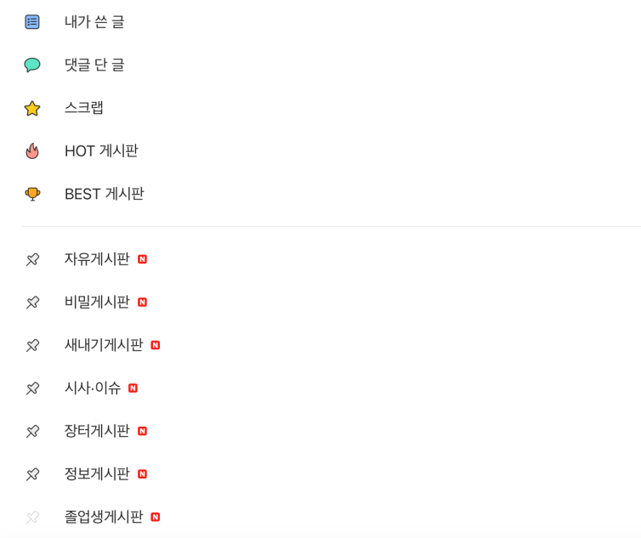
Mobile app API development presentation
Key Features
1. Display Board Titles: Clearly shows the names of each bulletin board for easy navigation.
2. Identify Pinned Boards: Allows users to pin their favorite boards for quick access, which appear at the top of the list.
3. Check for New Posts: Indicates whether there are new posts in each board for the current day.

Slide 5
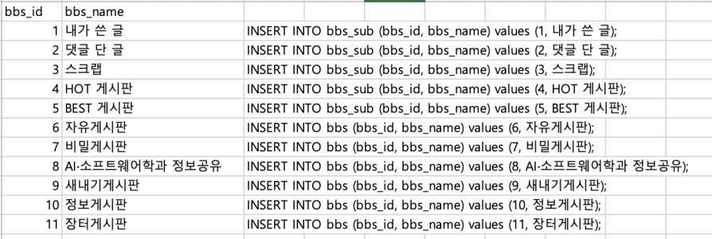
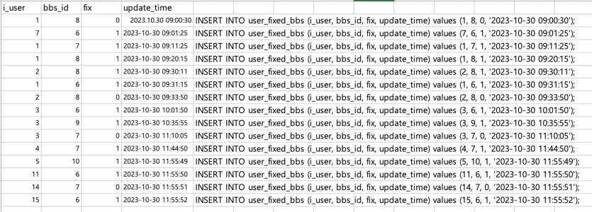
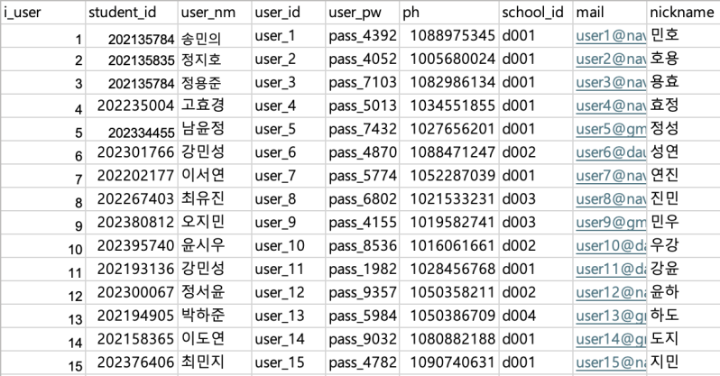
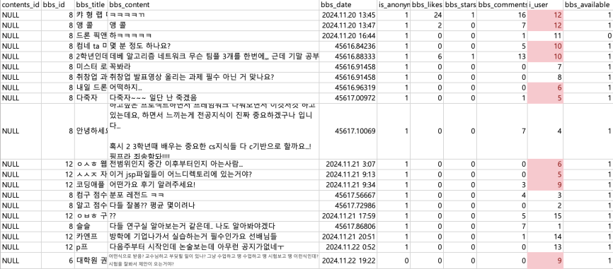
Mobile app API development presentation
bbs table
user_fixed_bbs table
user table
contents table

Slide 6


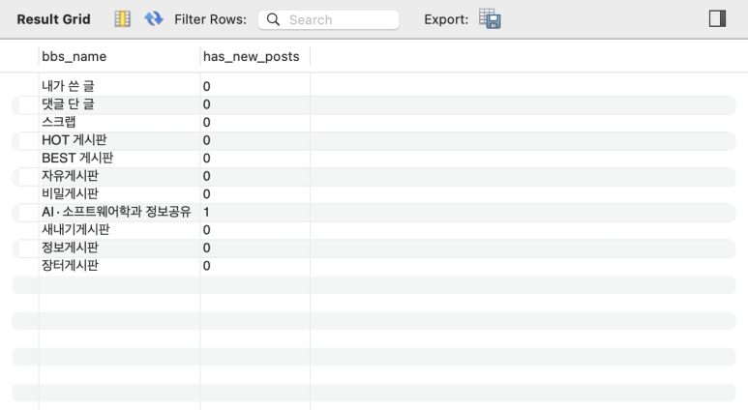
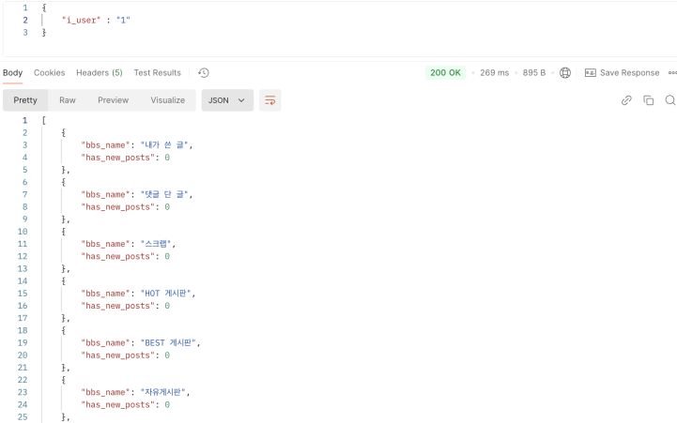
Mobile app API development presentation
SQL
API

Slide 7

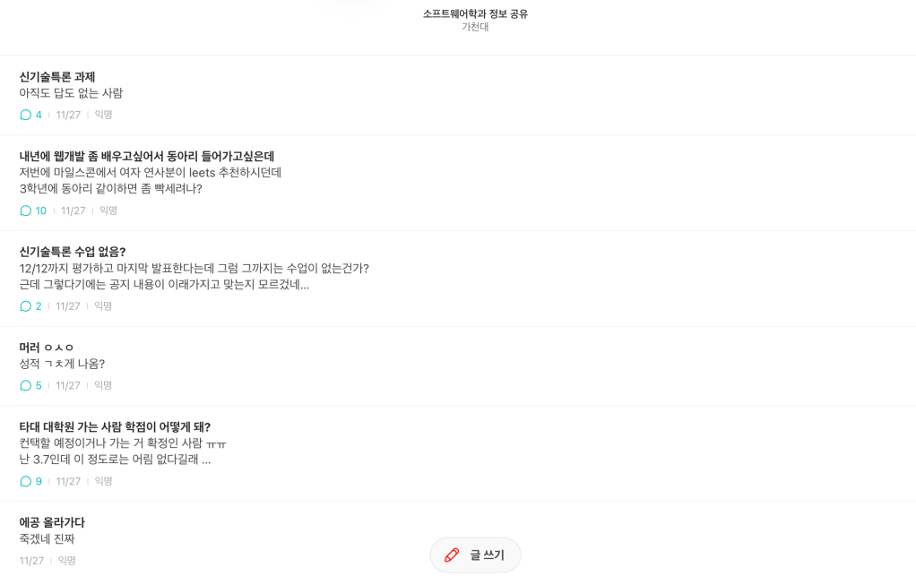
Mobile app API development presentation
Key Features
1.Content Truncation: If the post exceeds a certain length, it is truncated with “…” for a clean display.
2.Time Display: Display the post time dynamically, such as “just now” for under 60 seconds or “x minutes ago” within an hour.
3.Nickname Display: Adjust nickname visibility based on the user’s preference for anonymity.

Slide 8
Mobile app API development presentation
user table
contents table

Slide 9
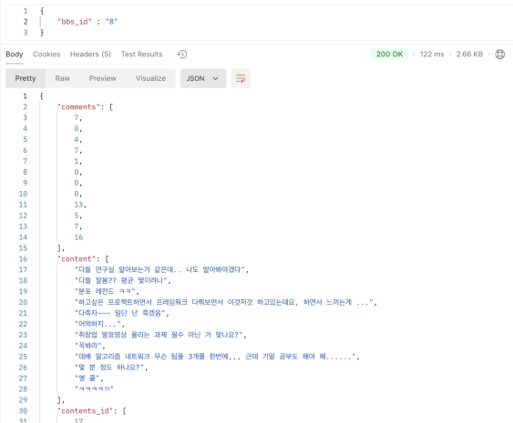
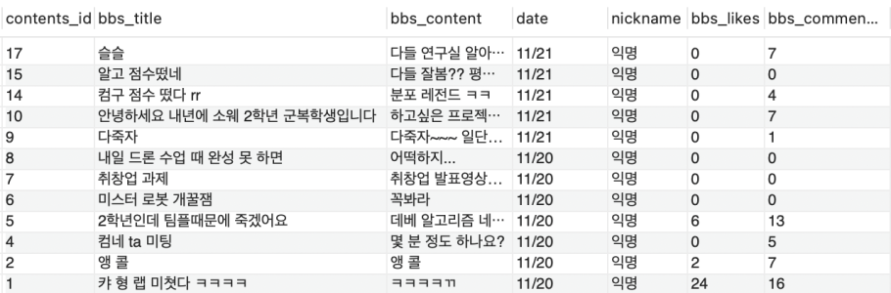
Mobile app API development presentation
SQL
API

Slide 10

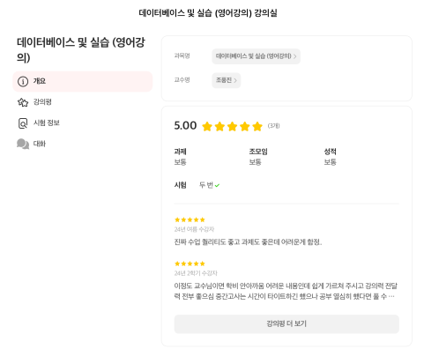
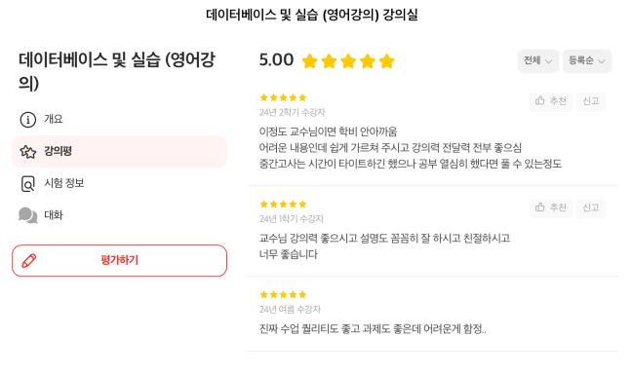
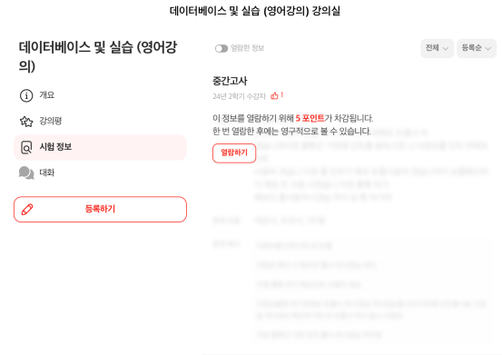
Mobile app API development presentation
Overview View
Review View
Exam Info View
Provides basic course information, including the course name and average rating, for a quick understanding of the course.
Features user reviews with strengths, weaknesses, and a star rating system to gauge satisfaction.
Offers insights on exams, including format, difficulty, and tips from past students to aid current learners.

Slide 11
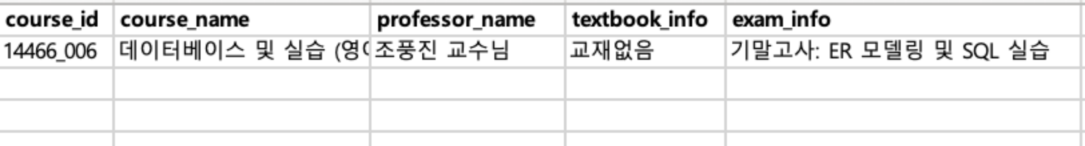
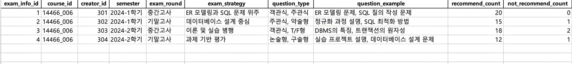
Mobile app API development presentation
course_table
ExamInfo_table
CousreEvaluation_table

Slide 12
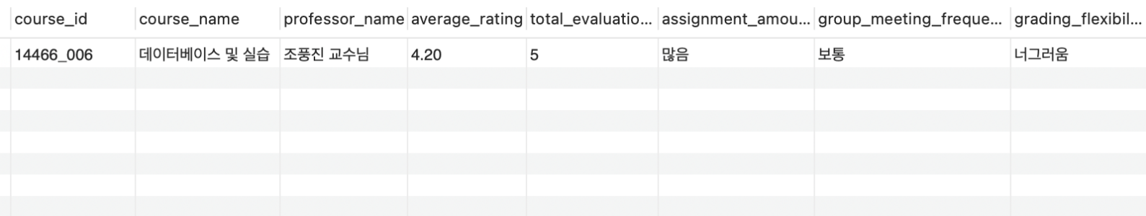
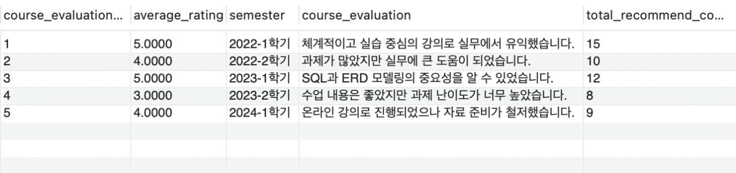
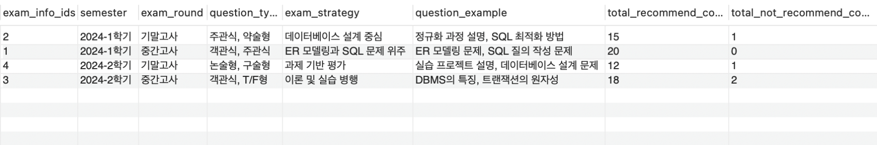
Mobile app API development presentation
SQL
Overview View
Review View
Exam Info View

Slide 13
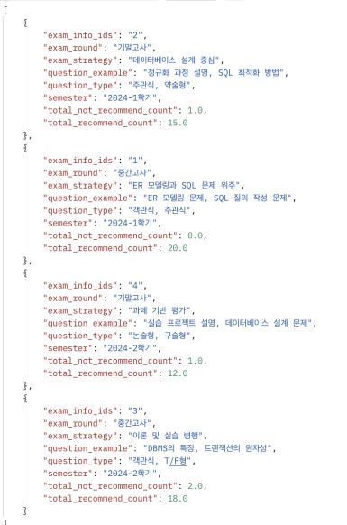
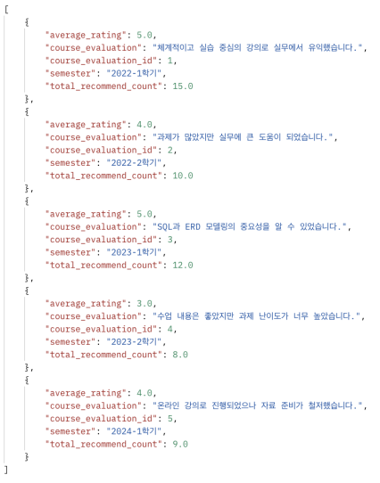
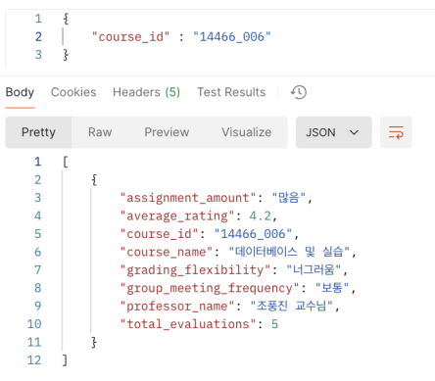
Mobile app API development presentation
Review View
Exam Info View
API
Overview View

Slide 14







Databases
Team Project
Mobile app API development presentation
TEAM 9 - 송민의, 정용준, 정지호, 고효경, 남윤정

